Slide 1
The Rock Cycle

Slide 2
By the end of this Smart Lesson you will be able to:
Explain the stages of the rock cycle and how rocks move between these stages.
Discuss the three types of rocks and the processes that form them.

Slide 3
The rock cycle is the process of how rocks become other types of rocks over huge periods of time.
Remember the water cycle? It’s the way water changes form and state in an endless cycle. The rock cycle is similar, except rocks change form over a much longer timescale.
Rocks change state in this process too, turning from solids to liquids at extreme temperatures of between 700°C and 1300°C.

Slide 4
Let’s look at the three types of rocks that are made in the rock cycle.
Igneous, Sedimentary & Metamorphic
These rock types are formed in different ways and have different properties.
First up are igneous [pronounced ig-knee-uss] rocks. They are formed from magma that has cooled and solidified.
Sedimentary [pronounced said-ah-men-tree] rocks are formed from the broken pieces of other rocks that have joined together.
Lastly, metamorphic [pronounced met-are-more-fic] rocks are formed deep underground where heat and pressure combine to compress rocks into something new.

Slide 5
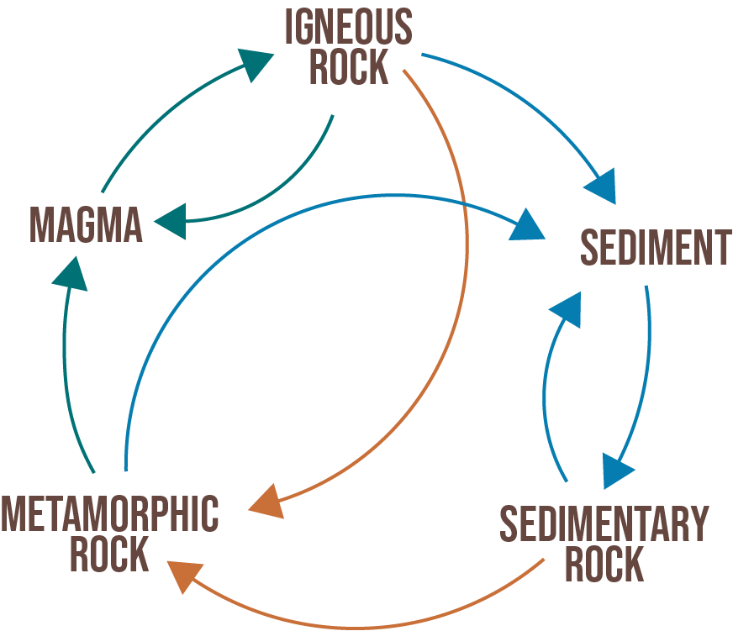
All rocks change over time.
Rocks are broken down, moved around and deposited in different places over thousands and millions of years.
They can be compacted together and pushed deep into the Earth, where they are melted or deformed by intense heat and pressure only to be uplifted again to the surface.
All of these processes combine to make the rock cycle—and it is indeed a cycle, with one form of rock changing into another, then another over eons. Rocks are gradually recycled over millions of years!

Slide 6
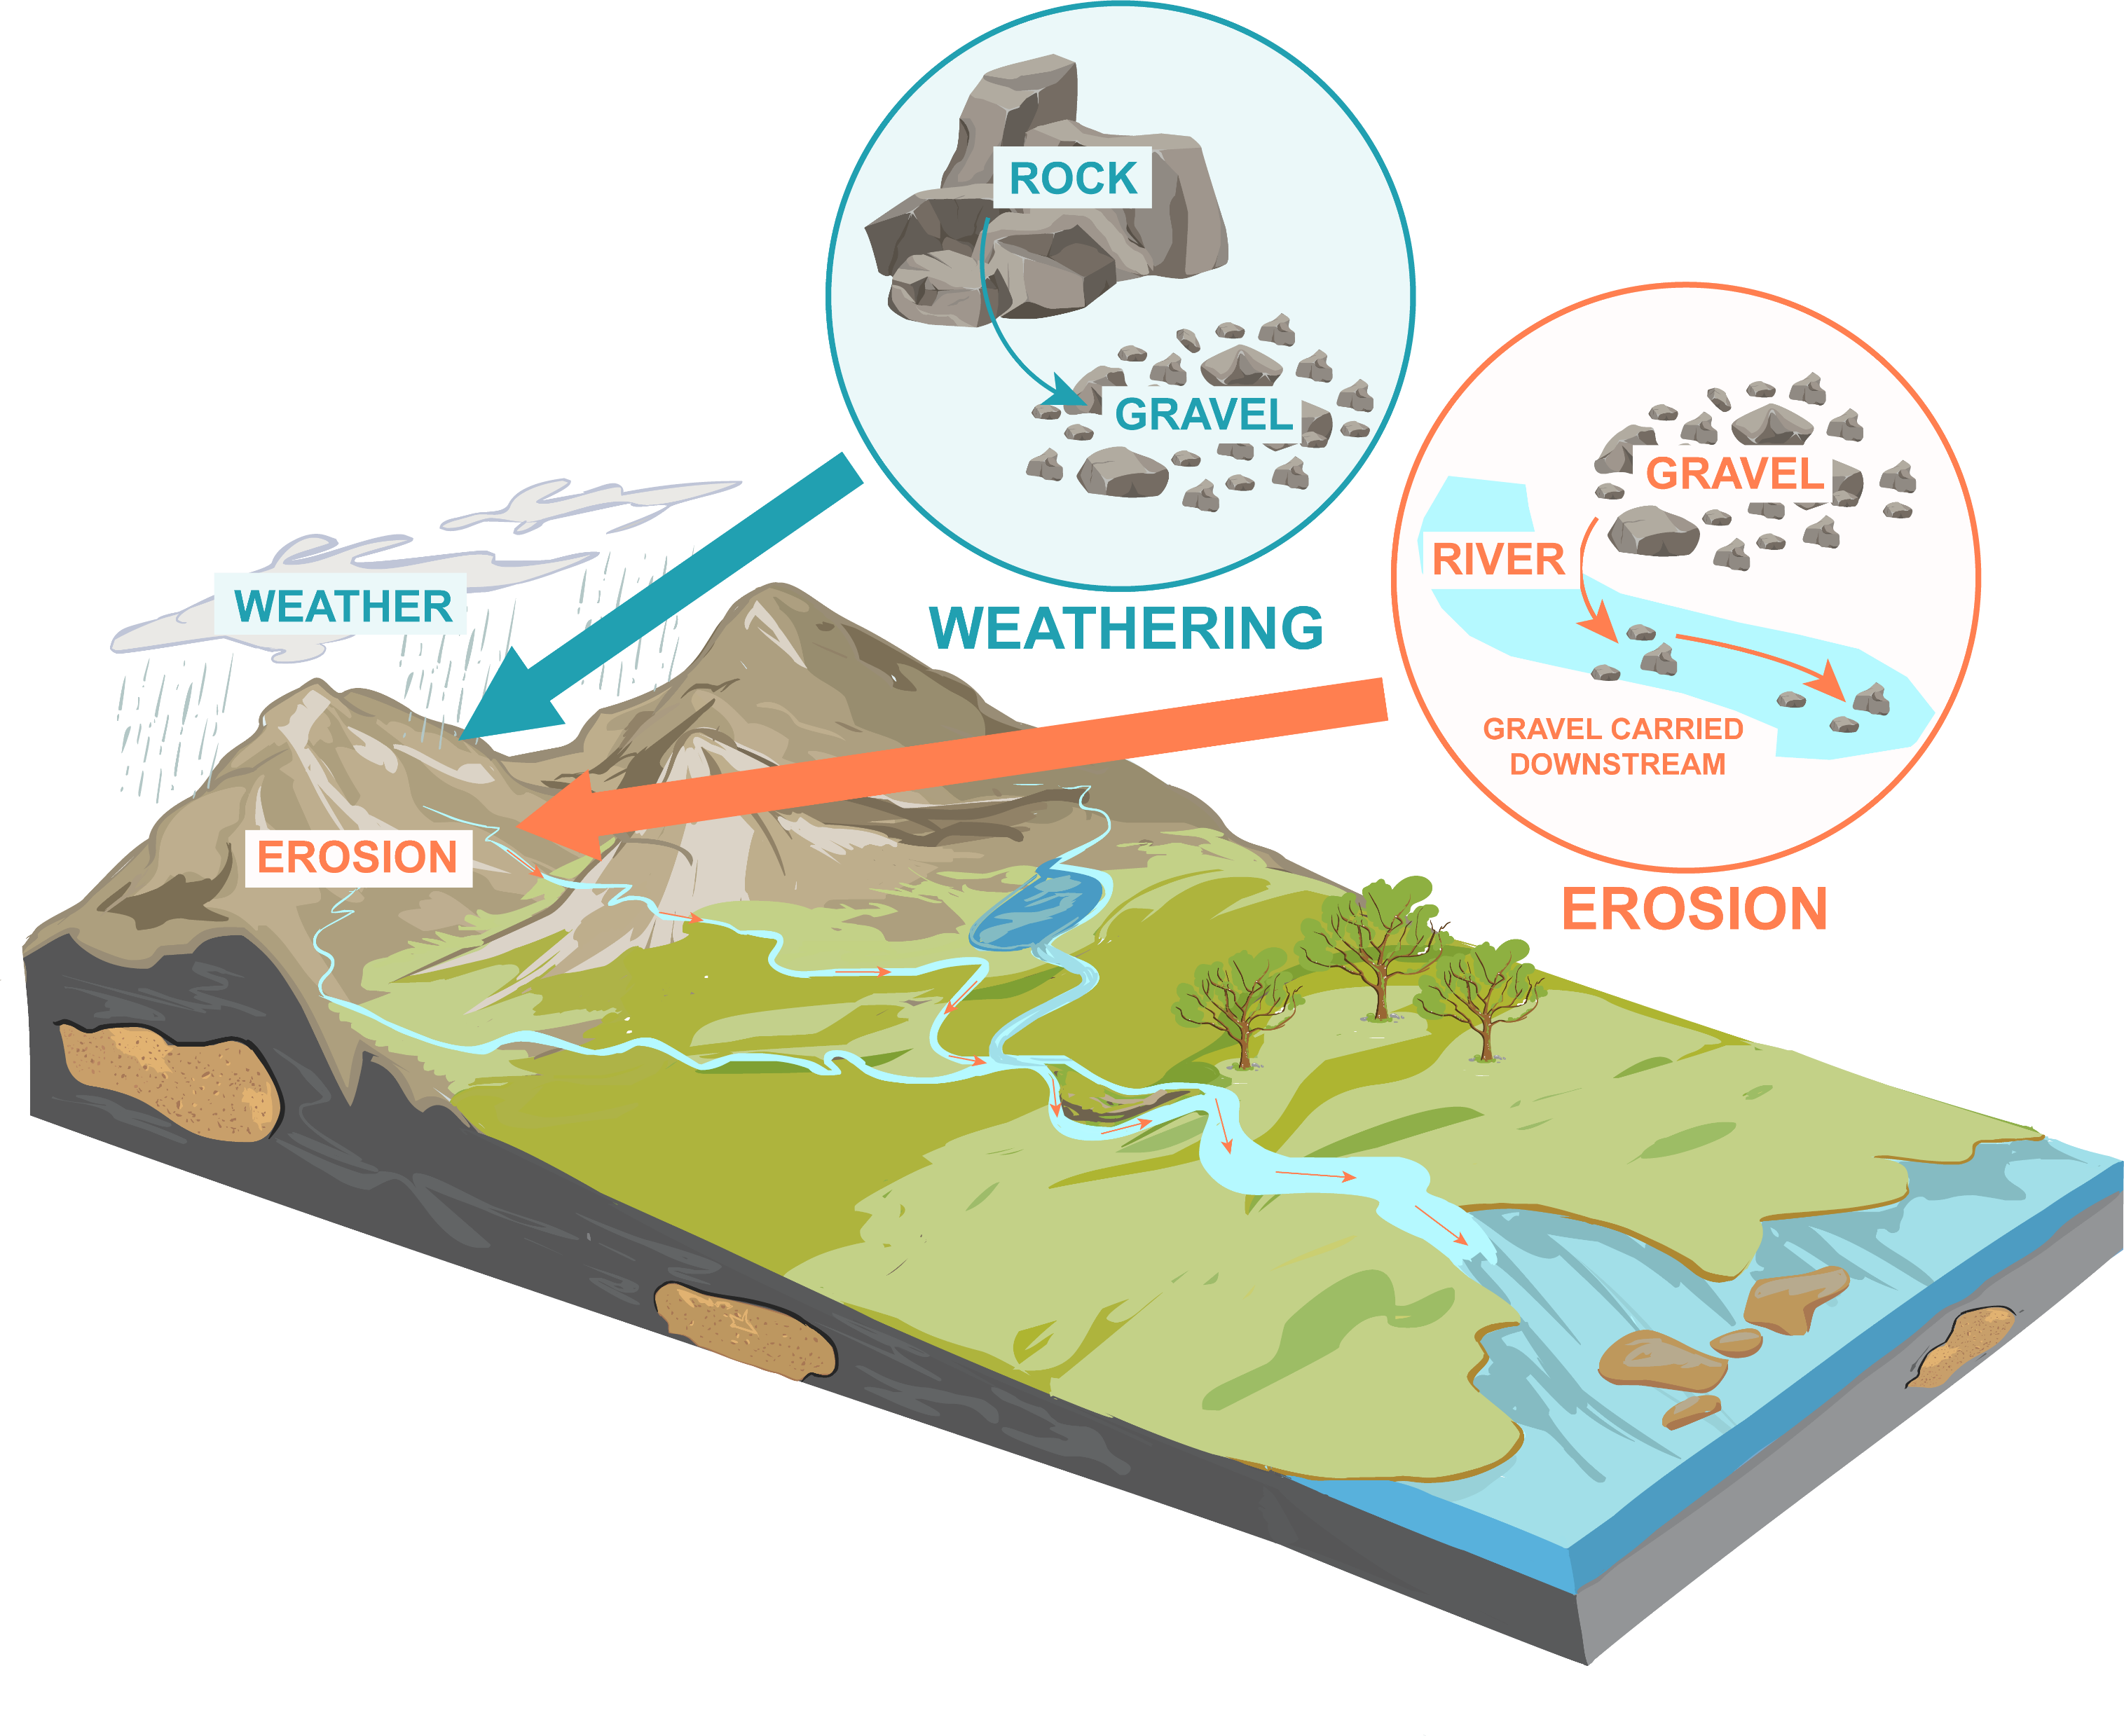
Rock Processes 1: Weathering and Erosion
Rocks are continually changing because of processes such as weathering, erosion and large earth movements. The resulting rock type depends on the process they undergo to change.

Slide 7
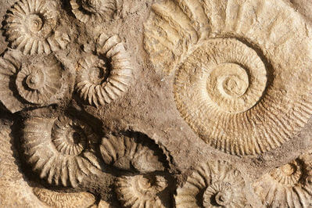
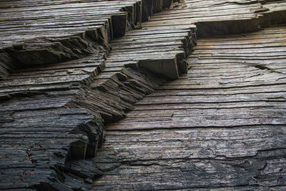
Rock Processes 2: Compaction and cementing
Eventually, these sediments collect at the bottoms of oceans and lakes, where they are compacted together to make sedimentary rock like limestone. This process from sediments being deposited, to being compacted and then cemented into sedimentary rocks takes millions of years.
These sediments are laid down in layers over time. As the weight of these layers compacts (squashes down) the sediment grains, these grains are gradually cemented together by minerals from the water. The result is gorgeous bands or grooves through the rock that give a sense of growth over time, like growth rings in trees.

Slide 8
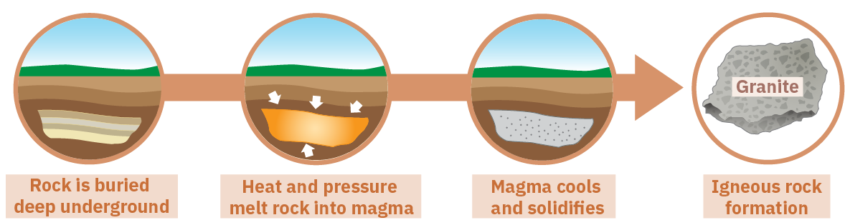
Rock Processes 3: Extreme Heat
When rock is melted at extreme temperatures and then cooled, it always becomes igneous rock.
This cooling and solidifying of igneous rock is called crystallisation. This can happen quickly (in a matter of minutes) in the case of erupting volcanoes or much more slowly underground.

Slide 9
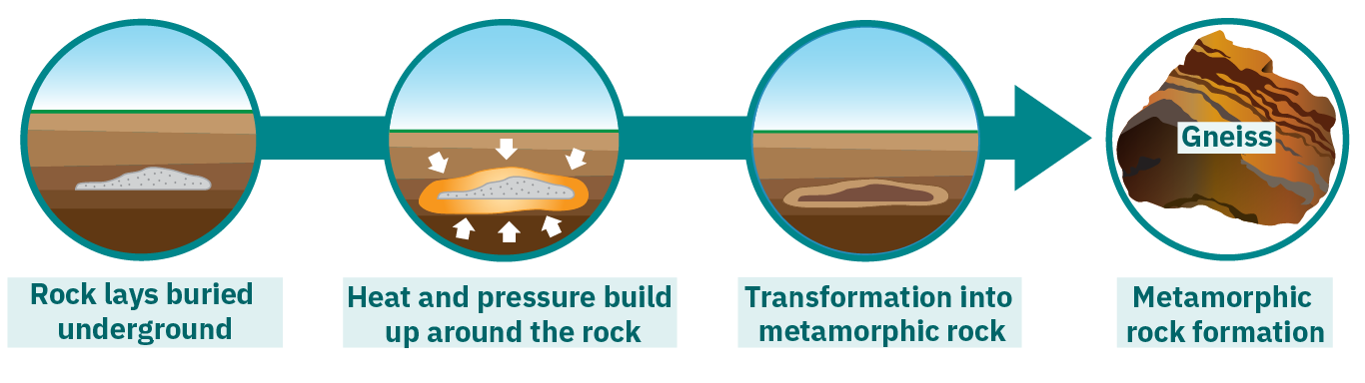
Rock Processes 4: Heat and Pressure
Likewise, if you take any rock and place it under huge pressure with high temperatures then it will become metamorphic rock.
This occurs when earth movements cause rocks to be deeply buried or squeezed. Conditions like these are found deep within the Earth or where tectonic plates meet. Under these conditions, metamorphic rocks do not melt.

Slide 10
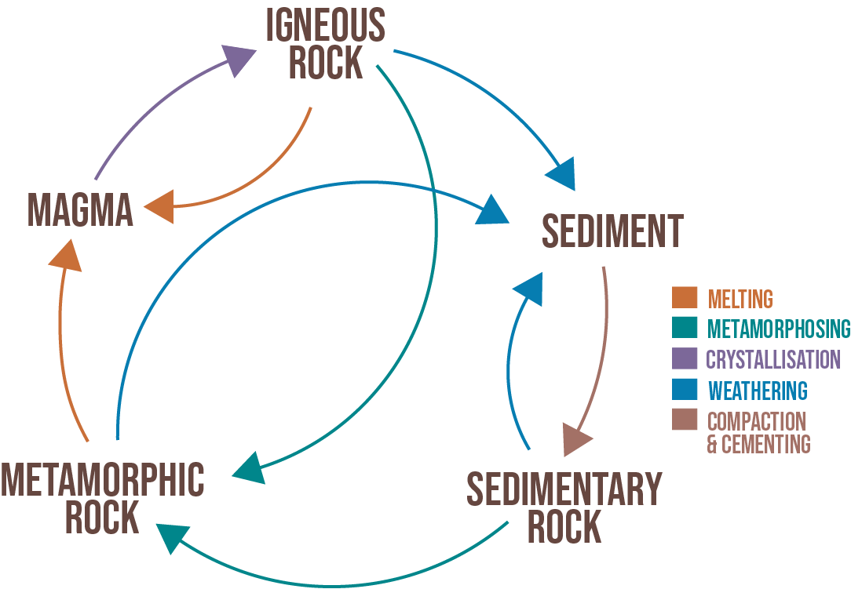
It is a visual summary of all the ways one rock type can change into another rock type, and the processes that cause these changes.

